Slide 1
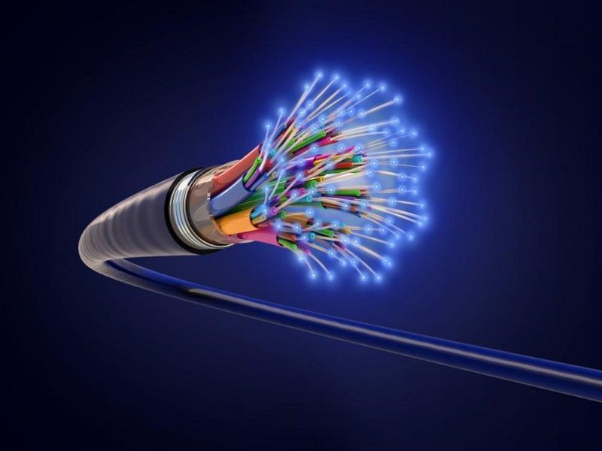
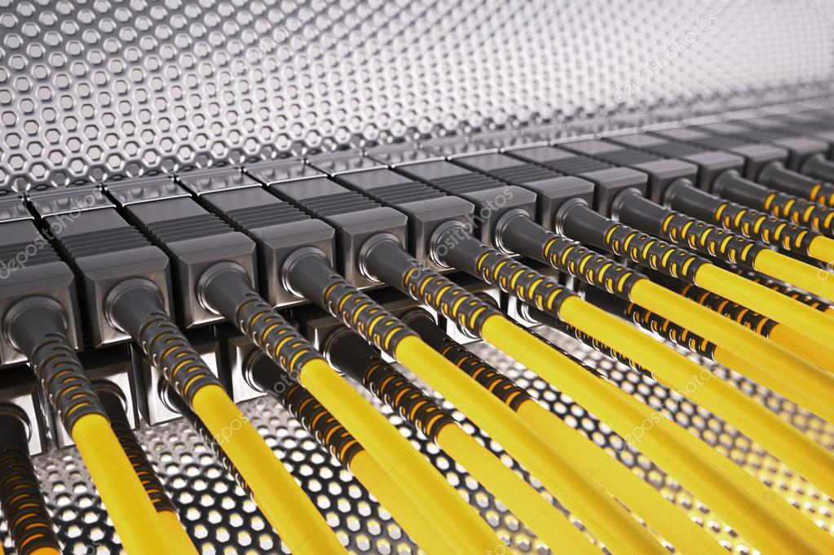
CORPERATE
PROFILE
2022
METEBUR GENERAL
MERCHANT
LIMITED
RC 1747144
CREATING NEW POSSIBILITIES....

Slide 2

MGM
limited
ABOUT US
METEBUR GENERAL MERCHANT LIMITED (MGM) is a Limited Liability Company with RC No 1747144 registered with Corporate affairs Commission (CAC). Located at No.7 Suite C24 Prime Hub Plaza Zoo Road , Kano. MGM Ltd is a value-add distribution and installation service’s company which has been anticipating through specializing in fibre optic network solutions in Nigeria and beyond. Our experience includes installation and commissioning of up to 240 core fibre optic metropolitan rings, long-haul as well as business connections in Nigeria, within area for fixed telecom operators such as Cable & Wireless. MGM Ltd experience locally includes that of the industrial, telecom, security and premise environments. MGM Ltd specialized in blown fibre and blown mini cable solutions and has been involved with the method statement and training of Neotel Contractors in the initial rollout of micro duct in Cape Town, Durban and Johannesburg. Metebur General Merchant Limited is a Certified Fibre Optic Technically approved by the Fibre Optic Industry Association. While maintaining focus on continuous improvement on internationally adopted policies and procedures applicable to the technologies the company operates in. recognizing worldwide need for ground breaking expertise in telecom market, MGM Limited has begun focusing its extensive telecommunication experience and recourses in providing innovative and practical solution to clients.
MGM in partnership with Digital Service Providers, its a solutions that takes great pride in supplying, designing, and supporting digital solutions to the commercial and government organizations. We remain aggressive in pursuing ways to develop our expertise and improve performance. Our quality, dedication, ethics and performance are the foundation for our successful track record.
Our focused, sound and innovative approach is derived from the cumulative experience of our team members. As a result of their combined practical working experience with strong technology delivery capabilities, we are able to comprehend the client's service requirements, propose IT and creative strategies in line with the nature of the vision of a particular service and execute the project plan by building or implementing high quality scalable system solutions through the use of latest cutting edge Technologies.

Slide 3

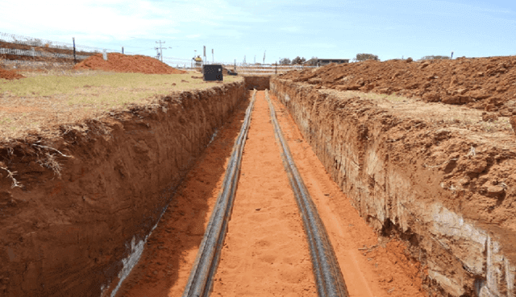
VISION & MISSION
STATEMENT
Vision Statement
Our vision is to be the a leading Optic Fibre technicians in a most dynamic value-add distribution and installation services company, creating sustainable solutions essential to a better, safer and healthier life for people everywhere.
Our Mission Statement
Our mission is to be the value-add distributor and telecoms construction company of choice in the regional areas and countries it operates in, by focusing on partnering, keeping and growing its customers by building positive long-term relationships. Relationships characterized by integrity, mutual respect and a commitment to providing customized products and services of the highest quality and value.
MGM
limited

Slide 4
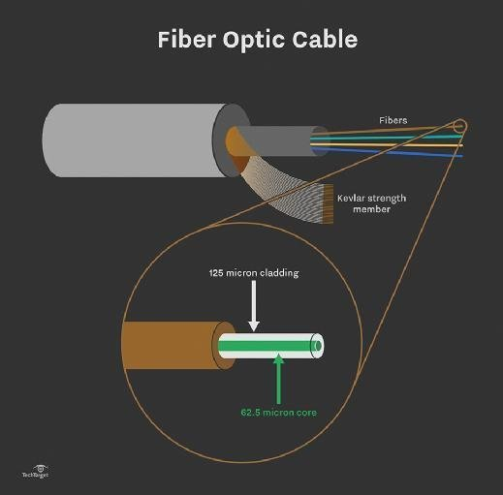
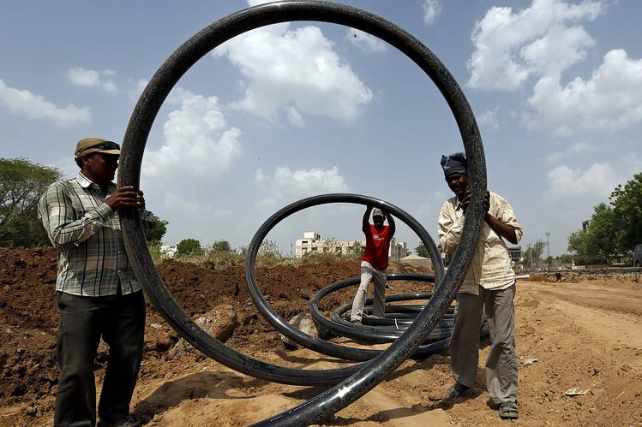
Our services
Our one-stop patronage solutios consist of the following services;
Fibre Optic Management
Cable Installation
Copper data Cabling
Fibre Optic Cabling
Switches & KVM solutions
Lockout-Tagout
Networking Enviroment
Safety Signs Installation
Cabling structured System
Wiring & Power Supply

Slide 5
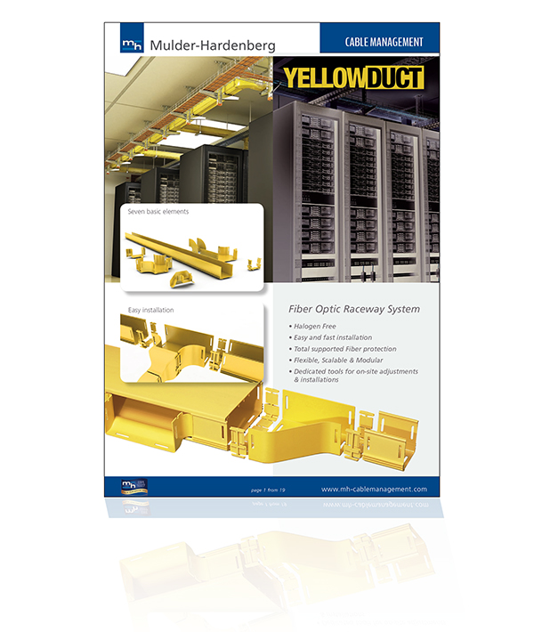
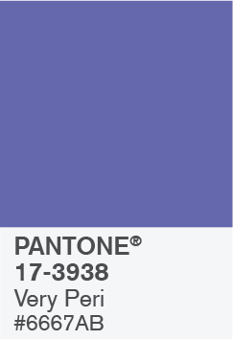

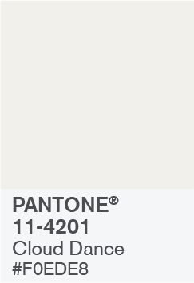
OUR CORPERATE DETAIL
Positioning
Pursuing Dreams
Experience & Reputation in Broad ranging with many leading manufacturers Optic Fibre Company’s & Equipment's.
Service excellence on providing top Quality throughout its portfolio of services. All work delivered through the company or its subcontractors will be supported for the duration of guarantee period.
Goal
Attracting customers, using contemporary approach
MGM
limited
Provision of platform for government, nongovernmental agencies, corporate bodies and individuals to create new possibilities in realizing professional and corporate visions and dreams
Motto

Slide 6
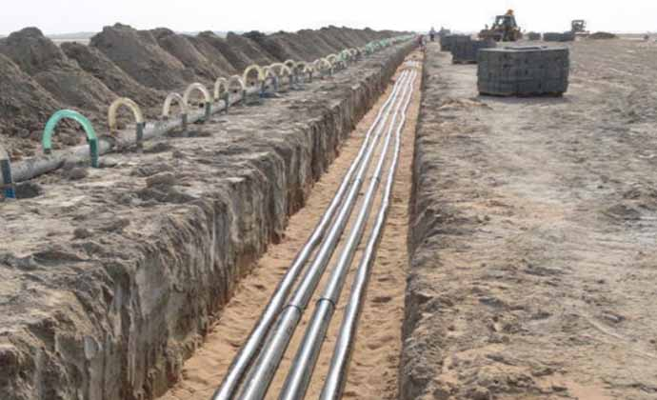
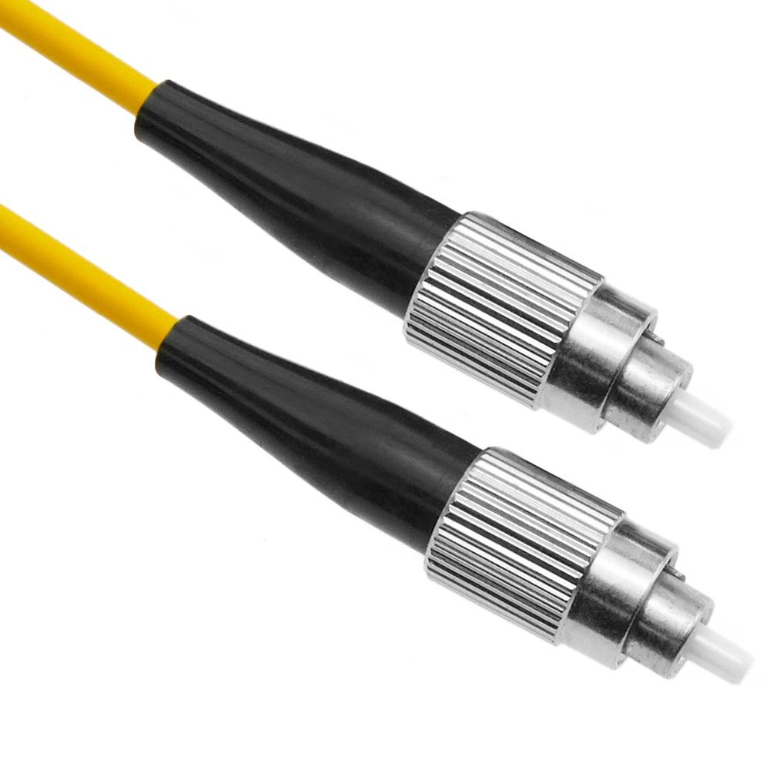
OUTPUT CAPACITY
100 Km of Duct Integrity Testing Per Month Team
Blowing
30 × 144F Dome Joints Per Month Per Slicing Team
1ooKm of Blowing Services Per Month Per Team
DIT
Splicing
With the infrastructure MGM Ltd Fibre Optics Services currently operates, we can commit to the following output capacity for spurs trenching, duct integrity testing, blowing and splicing:
Total Capacity Output: Duct Integrity Testing Approximately 150-200km per month.
Blowing Services – Approximately 200km per month.
Splicing Services – Approximately 5000 splices per month.

Slide 7
MGM LTD SPUR
Approximately 10Km’s route trenching per month.
DIT
Approximately 150-200Km per month.
Approximately 200Km per month.
Approximately 5000 splices per month.
Trenching
Blowing
Splicing
With the infrastructure MGM Ltd Fibre Optics Services currently operates, we can commit to the following output capacity for spurs trenching, duct integrity testing, blowing and splicing:
Total Capacity Output:
Trenching – Approximately 10km’s route trenching per month
Duct Integrity Testing – Approximately 150-200km per month.
Blowing Services – Approximately 200km per month.
Splicing Services – Approximately 5000 splices per month.

Slide 8
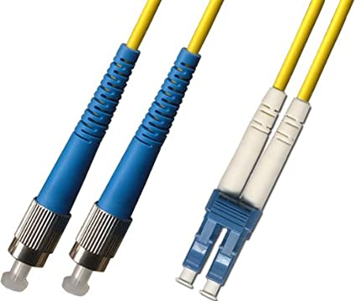
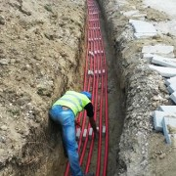
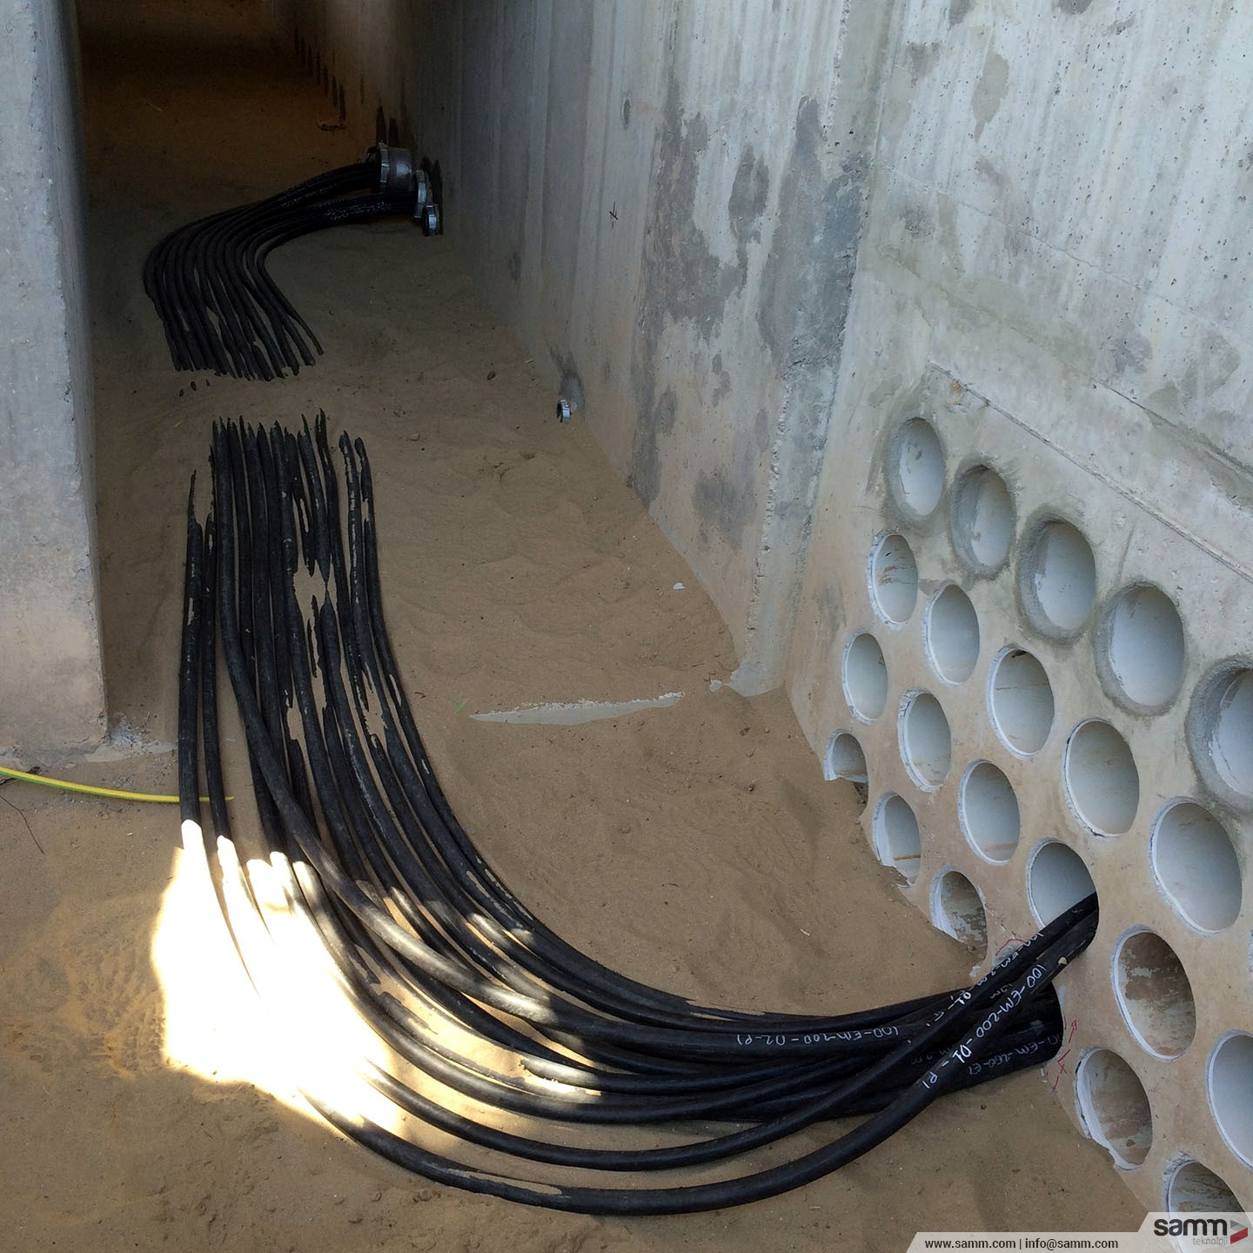
Access Builds:
With the infrastructure MGM Ltd Fibre Optics services currently operates, we can commit to the following output capacity for access builds trenching, duct integrity testing, blowing and splicing:
Efficiency
Quality
Workmanship
With our staff dedicated to exceeding the specification of each site, MGM Ltd Fibre Optics services, we are geared to handle up to 30 Access Builds Per Month.
MGM
limited

Slide 9





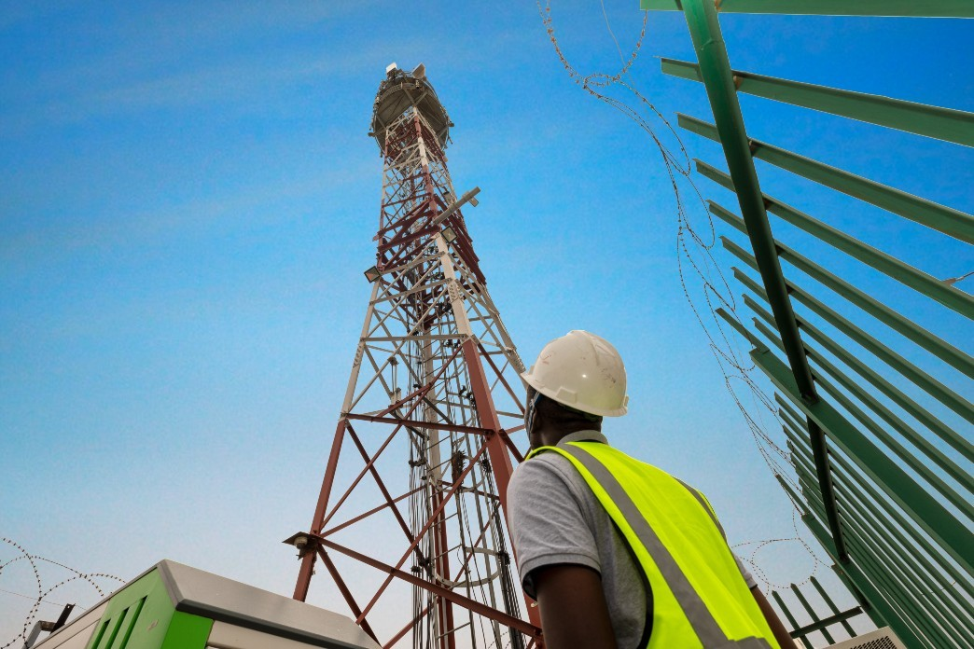

OUR CLIENTELE

Slide 10
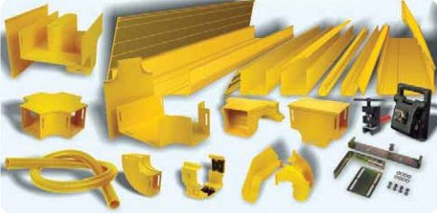
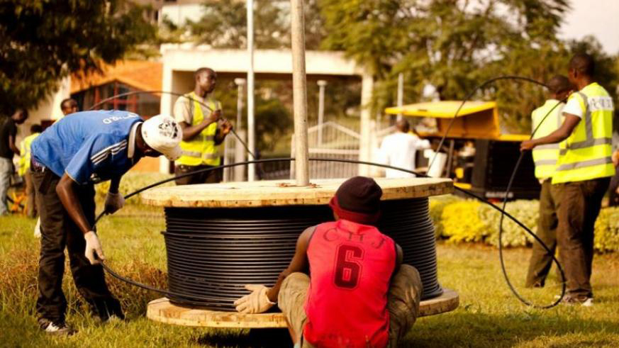
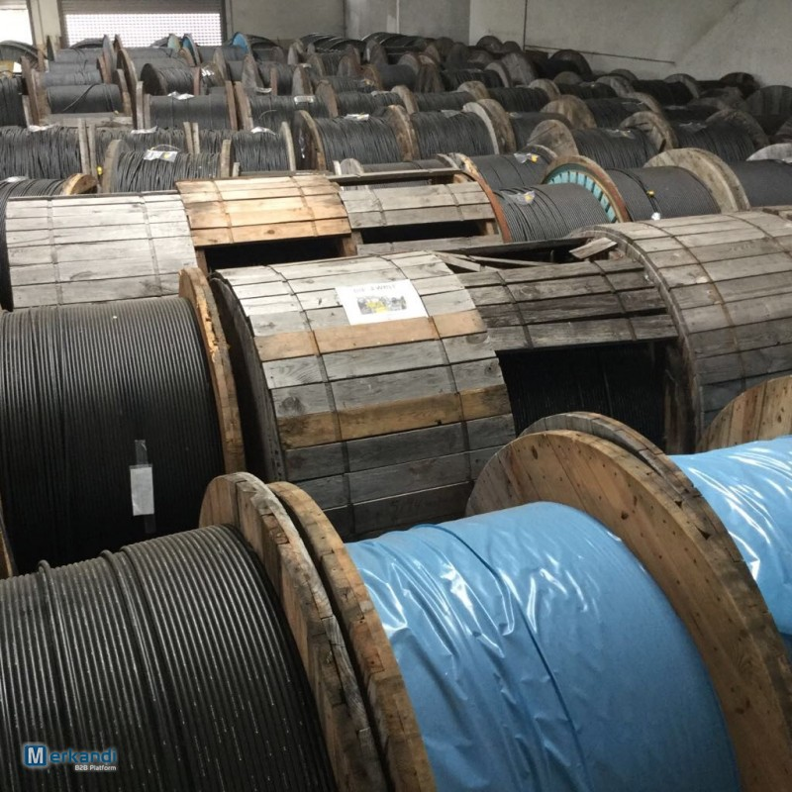
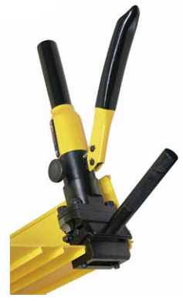
MGM
limited
The telecom sector plays a very important role for businesses and consumers worldwide as a provider for communication networks. The telecom sector consists of companies like network operators, mobile virtual network operators and telecom installers.
We at Metebur General Merchant Limited are specialized in a variety of service and solutions for the telecom industry. Our experienced staff has extensive knowledge of our wide assortment of high quality services and can help you decide whichever service is best for your situation. If desired we often help our clients to place their products to create customer-specific solutions.

Slide 11
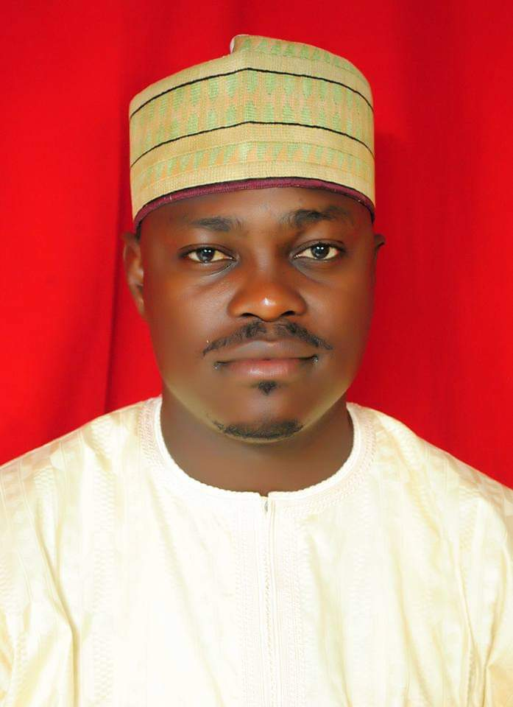
OUR CORE VALUES
The Core Values are the guiding principles that define relationship among the staffs of our clients;
Fairness
Firmness
Forthrightness
Integrity
Excellence
Professionalism
Responsiveness
Innovation
Commitment
Alhaji Aminu Ibrahim Kurawa
MD/CEO MGM Limited
MGM
limited

Slide 12
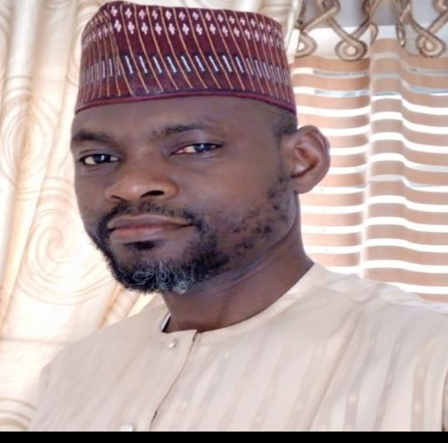
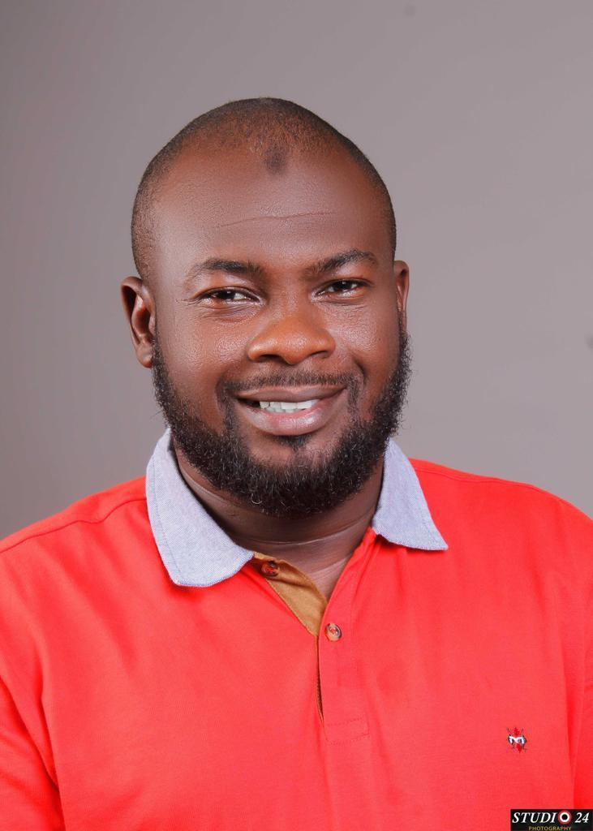
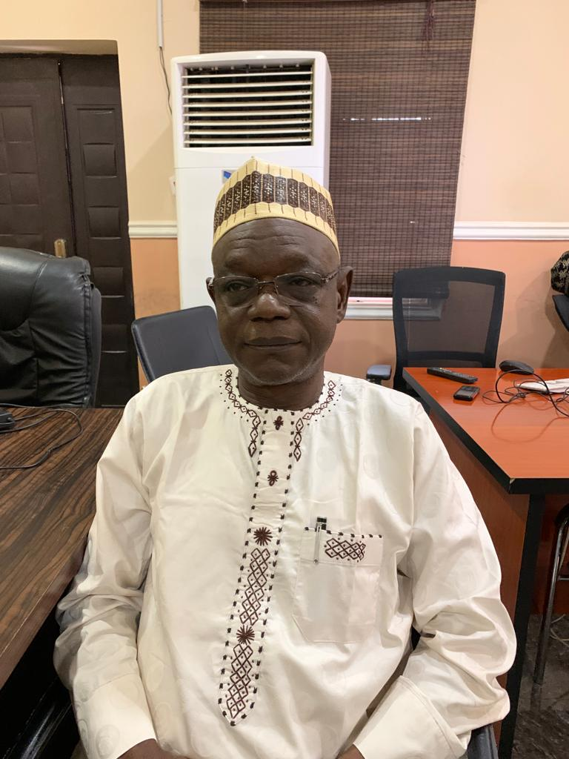
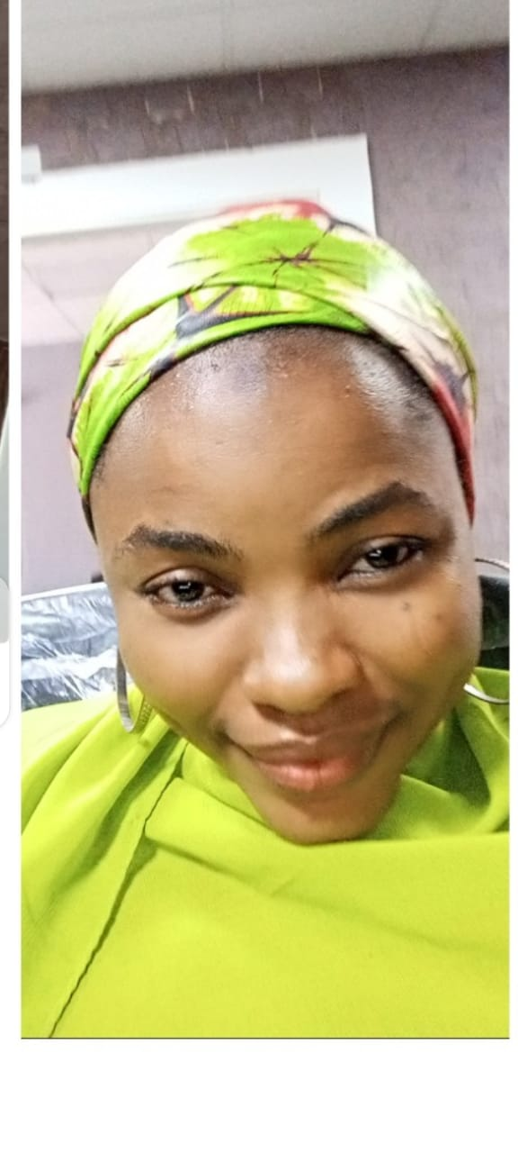
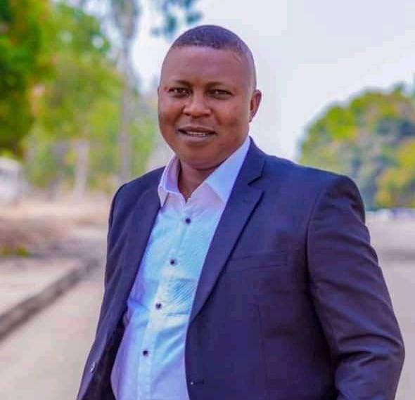
OUR TEAM
MGM
limited
Musa Abubakar Kurawa
Executive Director
Lukman Suleiman Kurra
Executive Director
Yusuf Mohd Bello Executive Director
Zainab Ishaq Usman
Human Resources Officer
Bindul Martins
Project Coordinator

Slide 13
OUR corporate details
MGM
limited

Slide 14
corporate details

Slide 15
corporate details
MGM
limited

Slide 16
corporate details
MGM
limited

Slide 17
corporate details
MGM
limited

Slide 18
CONTACT details
Aminu Ibrahim Kurawa
MD/CEO Metebur General Merchant Limited
No.7 suite C24 Prime Hub Plaza Zoo Road, Kano, Kano State
Tel: +234 – 8032255369, 08021111142, 08029273739
Email: meteburgeneralmarchant@gmail.com
Website: www.metebur.com
Creating New Possibilities………
MGM
limited
RC 1747144

Slide 19

acknowledgement seal
MGM
limited
Our Client:
DATE:
SIGNED/SEAL:
Metebur General Merchant limited:
DATE:
SIGNED/SEAL:
This is to certify our Client and MGM Limited having received the profile and acknowledged.

